Slide 1
Assessment 2
BCDE211 Best Programming Practices (Web and Mobile Development)
User Story and UML Class Diagram

Slide 2
User Story
1. Workout Container (WorkoutManager class)
As a user, a centralized workout manager would be helpful so all training sessions can be accessed and managed in one place.
2. Add a Workout
As a user, I think I can manage the new training sessions more easily and accurately with a pre-filled form with default values and input validation.
3. Sort Workouts
As a user, an app that can sort based on type and date would be helpful for easy organization and effective review of all my workouts.

Slide 3
4. Search/Filter Workouts
As a user, I want to search for or filter workouts based on categories, so that I can find may session easily.
5. Delete a Workout
As a user, I want to delete the workouts that I don't need anymore, to be able to see those that I only need.
6. Save to Local Storage
As a user, I want an automatic Local Storage, so my workouts can be saved between sessions

Slide 4
7. Load from LocalStorage
As a user, I want an app that automatically loads the workouts that I saved from the Local Storage as soon as it starts to make sure that I don't lose my data.
8. Edit a Workout
As a user, I would want to revise or correct any mistakes by updating the details.
9. Revert Changes During Edit
As a user, I want to cancel any changes during editing so no unwanted details will be saved.

Slide 5
10. Input Validation
As a user, I want an app that only updates valid data.
11. Calculation Within a Workout
As a user, I want to evaluate the performance for the session of each workout be calculated.
12. Calculation Across Workouts
As a user, I want the app to track the overall progress by calculating the total distance and duration of all workouts.

Slide 6
13. Default Values for New Workout
As a user, I want to include the default values to be included in the new workout.
14. Get All Workouts
As a user, I think it would be useful to have a system where I can get a list of all my workouts for me to track the training history.
15. CRUD via Database
As a user, I want an adjustable storage to save my workouts, to easily and securely manage larger data sets.

Slide 7
16. Handle Errors and Edge Cases
As a user, I want an app that can handle errors effectively and must not crash and lose the data.

Slide 8
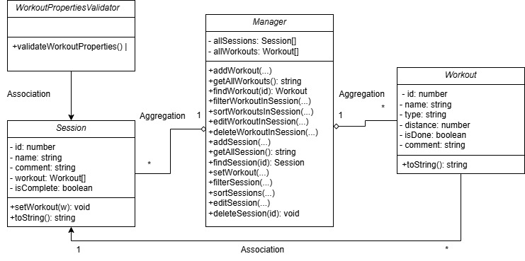
UML Class Diagram

